Slide 1
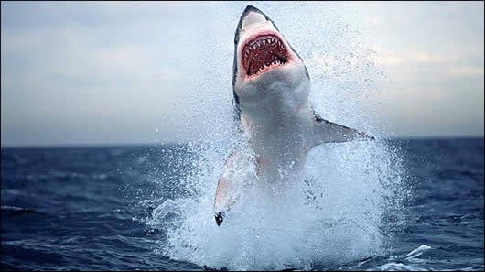
GREAT WHItE SHaRK
BY EMMA

Slide 2
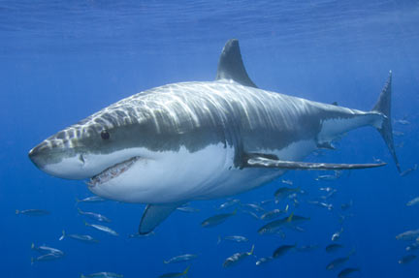
BODY
GROW UP TO 20 FEET

Slide 3
HABITAT
THEY ARE FOUND WORLDWIDE

Slide 4
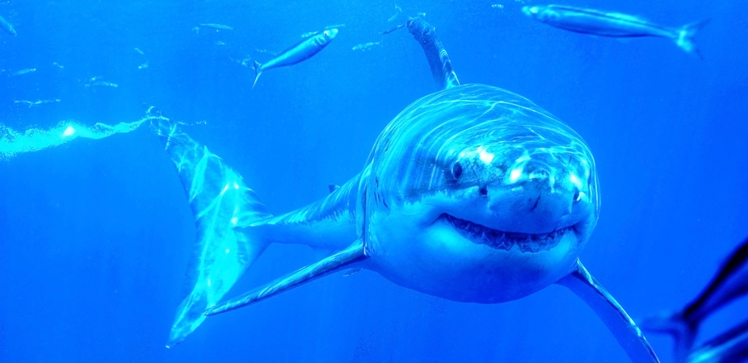
FOOD
WHITE SHARK SHUNT SEALS

Slide 5
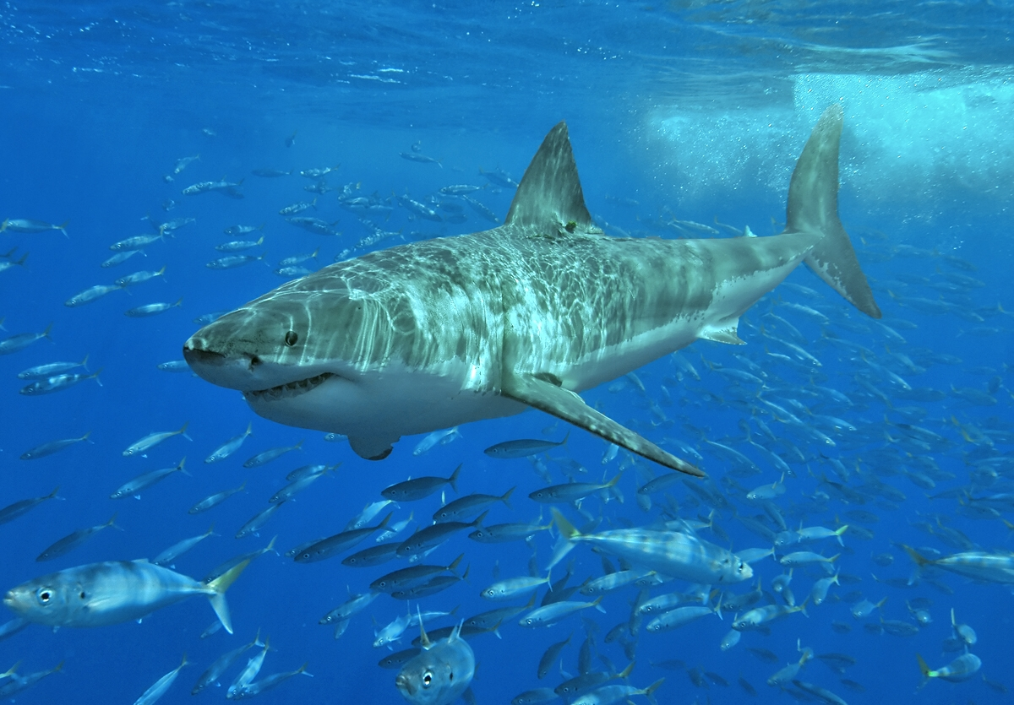
LIFE CYCLE
GIVE BIRTH TO BETWEEN TWO AND TEN PUPS

Slide 6
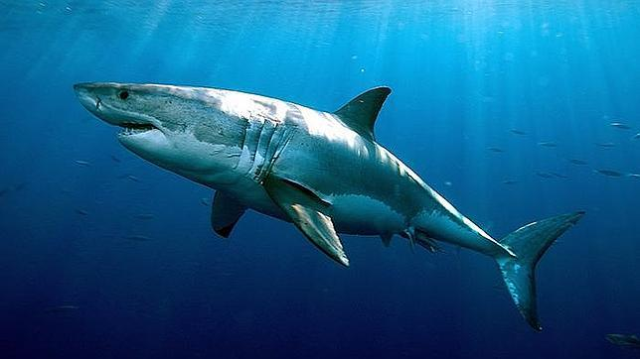
FUN FACT
SHARKS ARE ALSO CALLD WHITE SHARKS.

