Slide 1
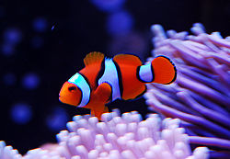
Clown fish
By Evelyn

Slide 2
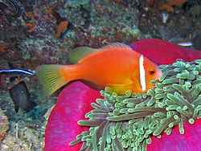
Body
Orange bodies and stripes.
They are 4 inches long.

Slide 3
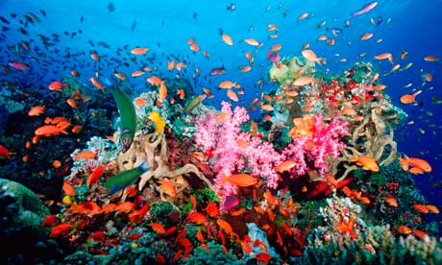
habitat
They live in the oceans that have coral reefs.

Slide 4
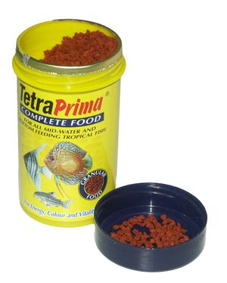
Food
They eat leftover fish parts.

Slide 5
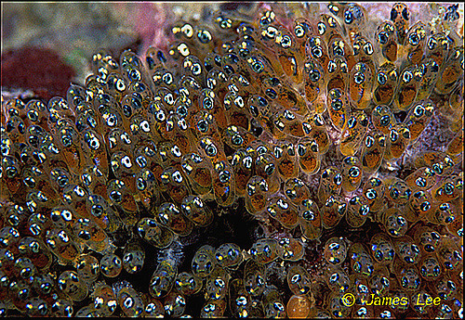
Life cycle
They lay eggs in coral reefs.
Both parents guard the eggs.

Slide 6
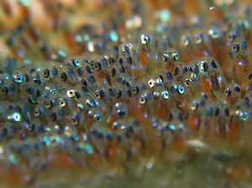
Fun Fact
They lays up to 1,000 eggs at a time.

