Slide 1
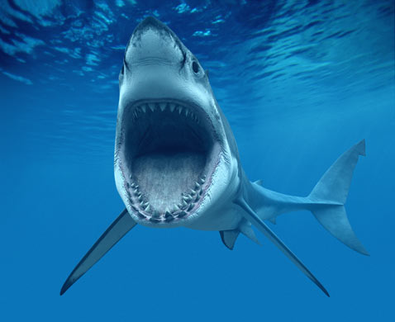
Great white
By Gavin hunerdosse.

Slide 2
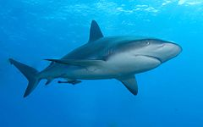
BODY
They grow up to 20 feet.
They have white under sides and gray backs.

Slide 3
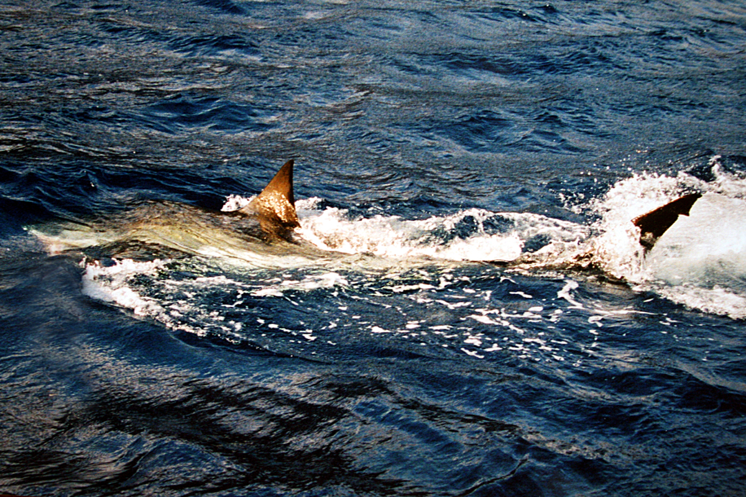
Habitat
They live in oceans. They are found word wide mostly in cool water.
They swim along shore to search for food.

Slide 4
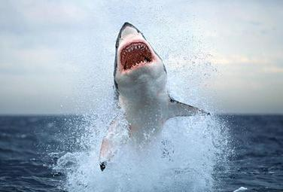
Food
They hunt seals sea lions and dolphins.
They can jump out of water to catch prey.

Slide 5
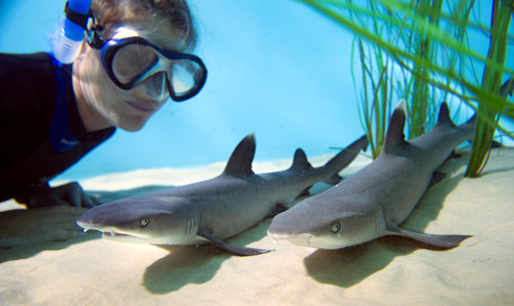
Life cycle
Female give birth to between two and ten pups at one time.
The pups live on their own.
They live about 25 years.

Slide 6
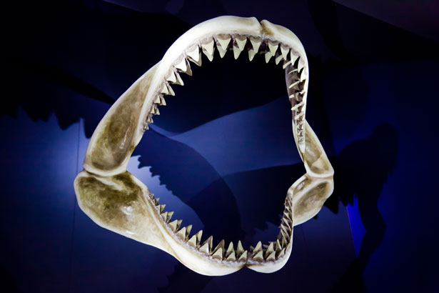
Fun fact
Great whites are also calld white sharks.
They also have more than 3000 teath.

