Slide 1
NursE SHARKS
BY KADEN JOHN CAPPS

Slide 2
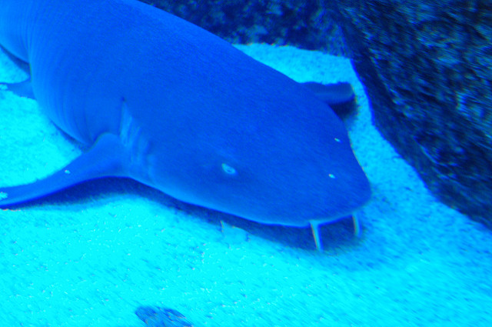
body
Thed are braoon and 10 feet 13 meters.

Slide 3
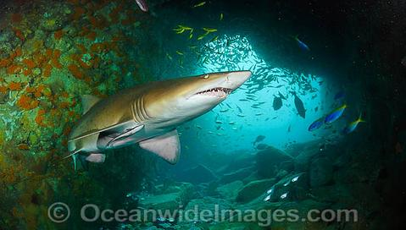
habitat
Warm shallow water.

Slide 4
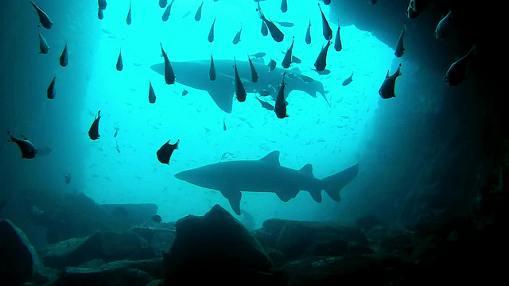
food
Fish and squid ,and shrimp

Slide 5
Life cycle
20 to 30 coral

Slide 6
F un fact
Thea can suck snals awt of ther shels.

