Slide 1
otcopuses
klayton

Slide 2
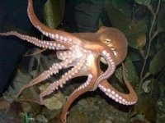
body
They have eight iong teacles

Slide 3
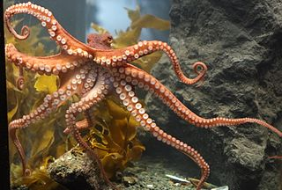
habitat
oceans

Slide 4
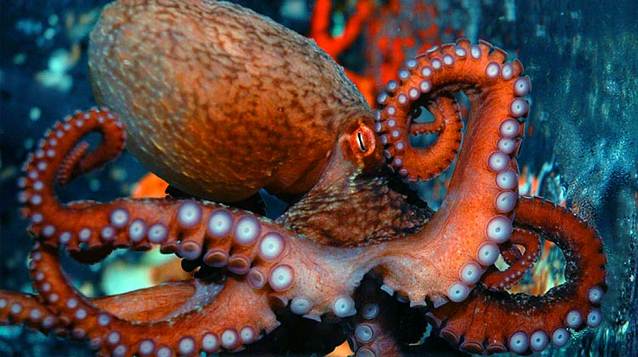
food
Shell fish

Slide 5
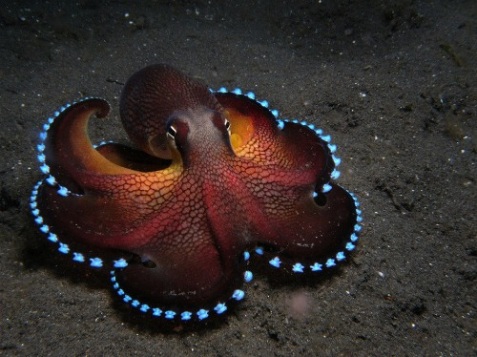
Life cycle
Thous and s of eggs

Slide 6
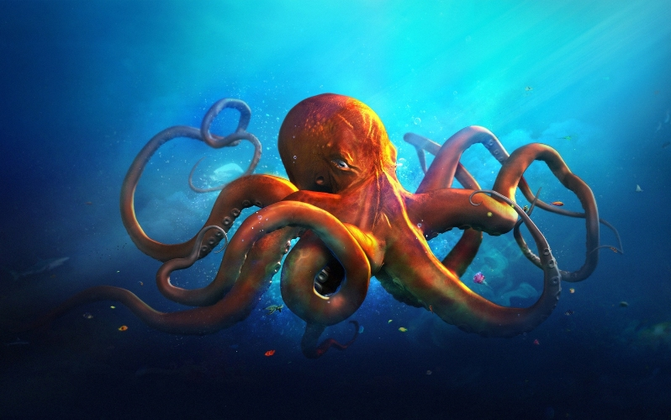
Fun fact
Shoot a cloud biack ink

