Slide 1
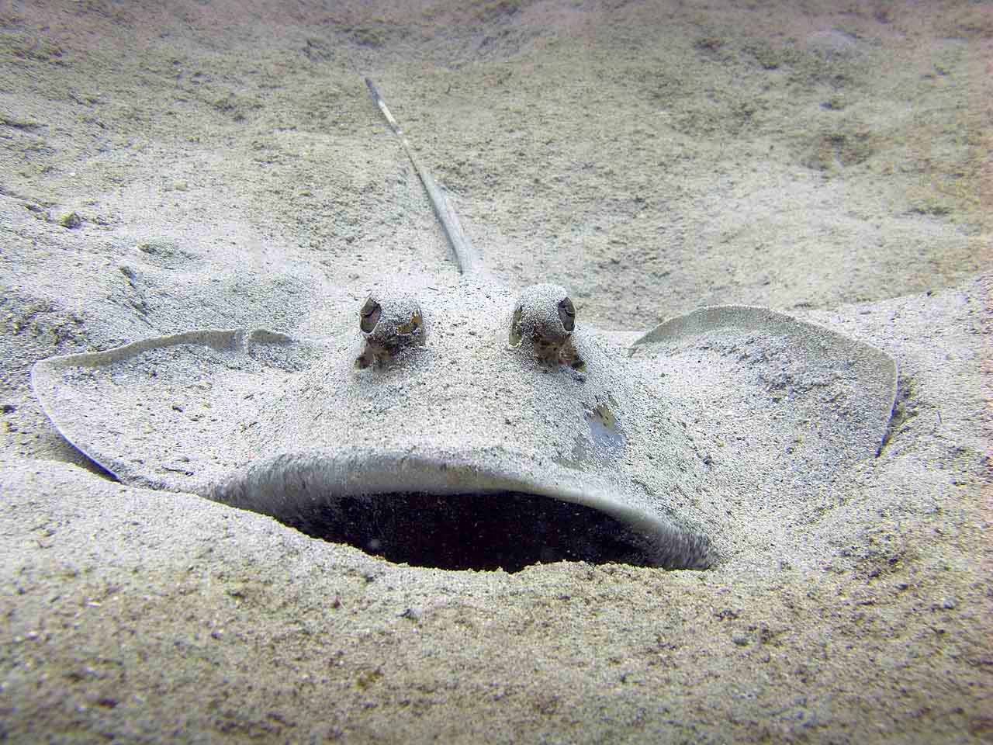
stingrays
By Layne price

Slide 2
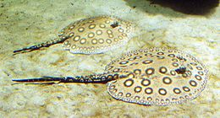
body
Stingrays are 22 feet

Slide 3
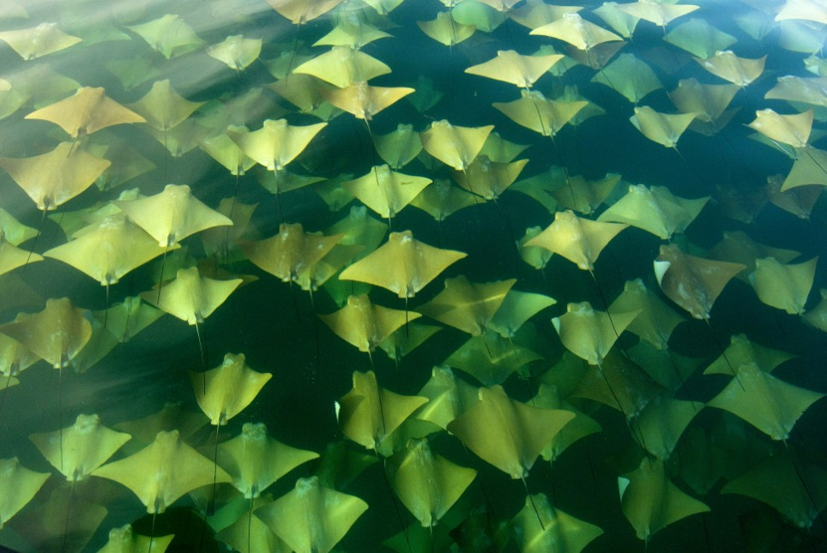
habitat
Stingrays live in shallow waters of warm seas .

Slide 4
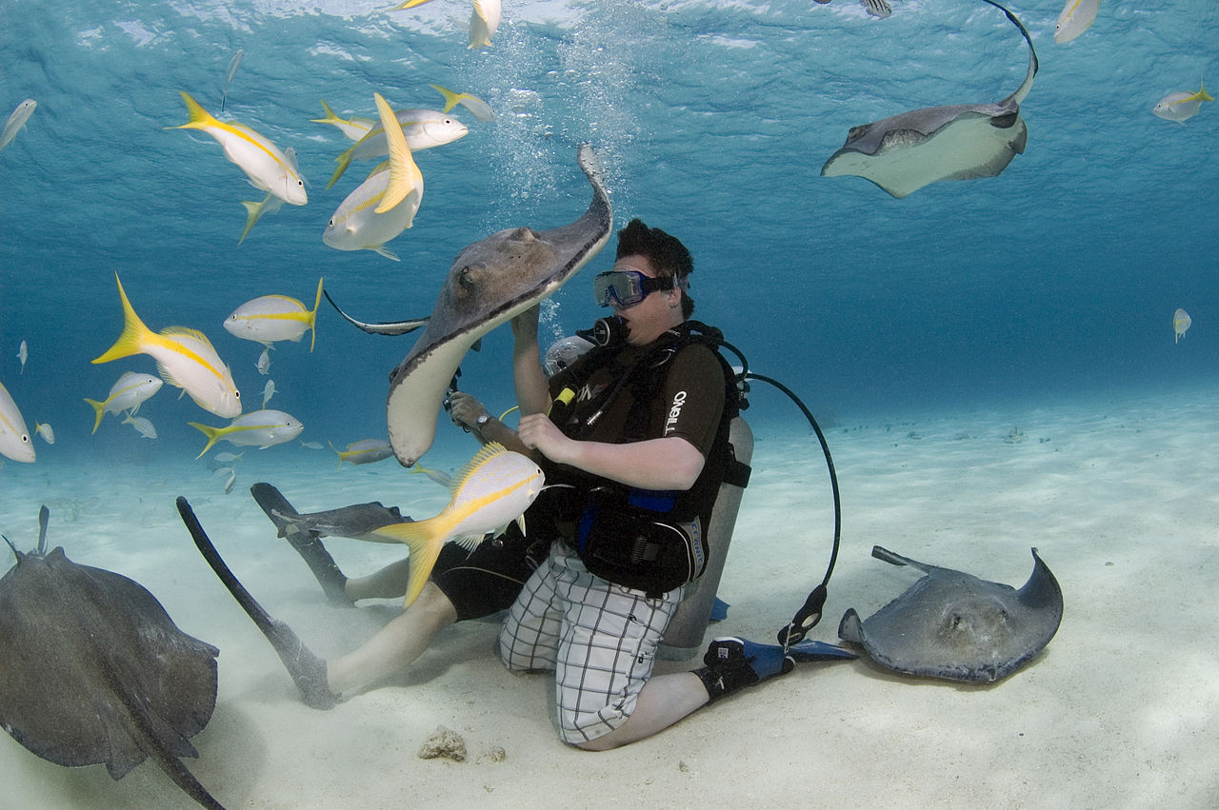
Food
Stingrays eat clams and oysters

Slide 5
Life cycle
Female stingrays lay eggs

Slide 6
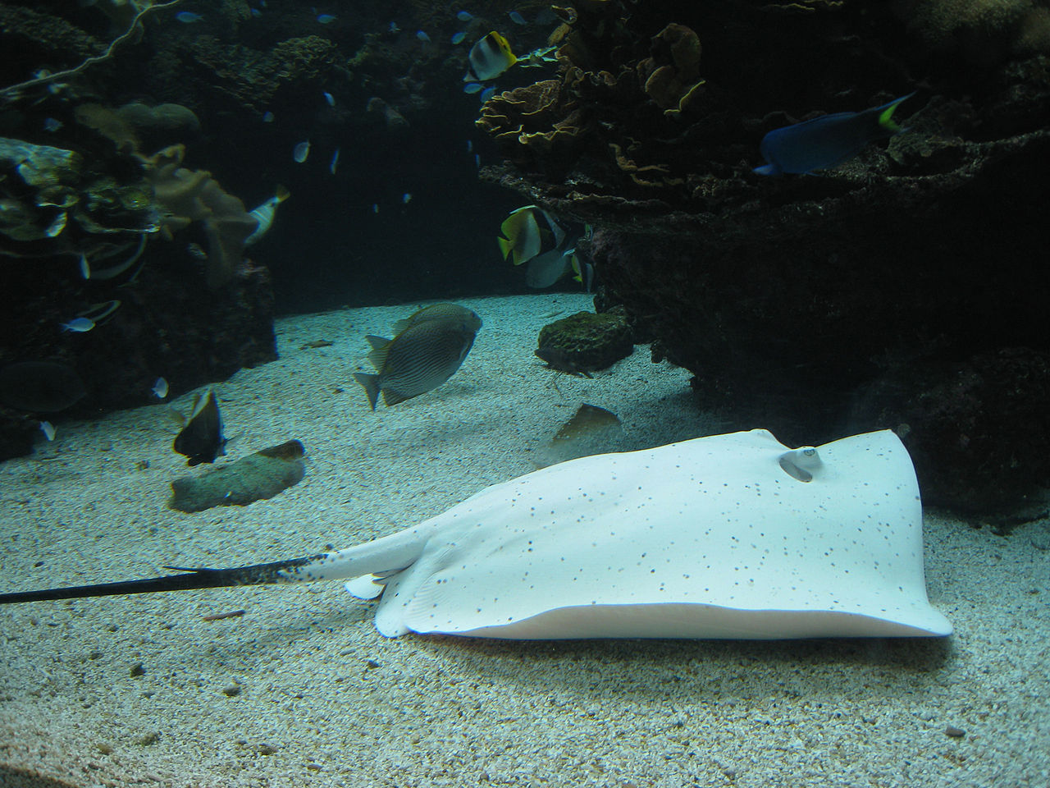
funfact
Stingrays live for 15 to 25 years.

