Slide 1
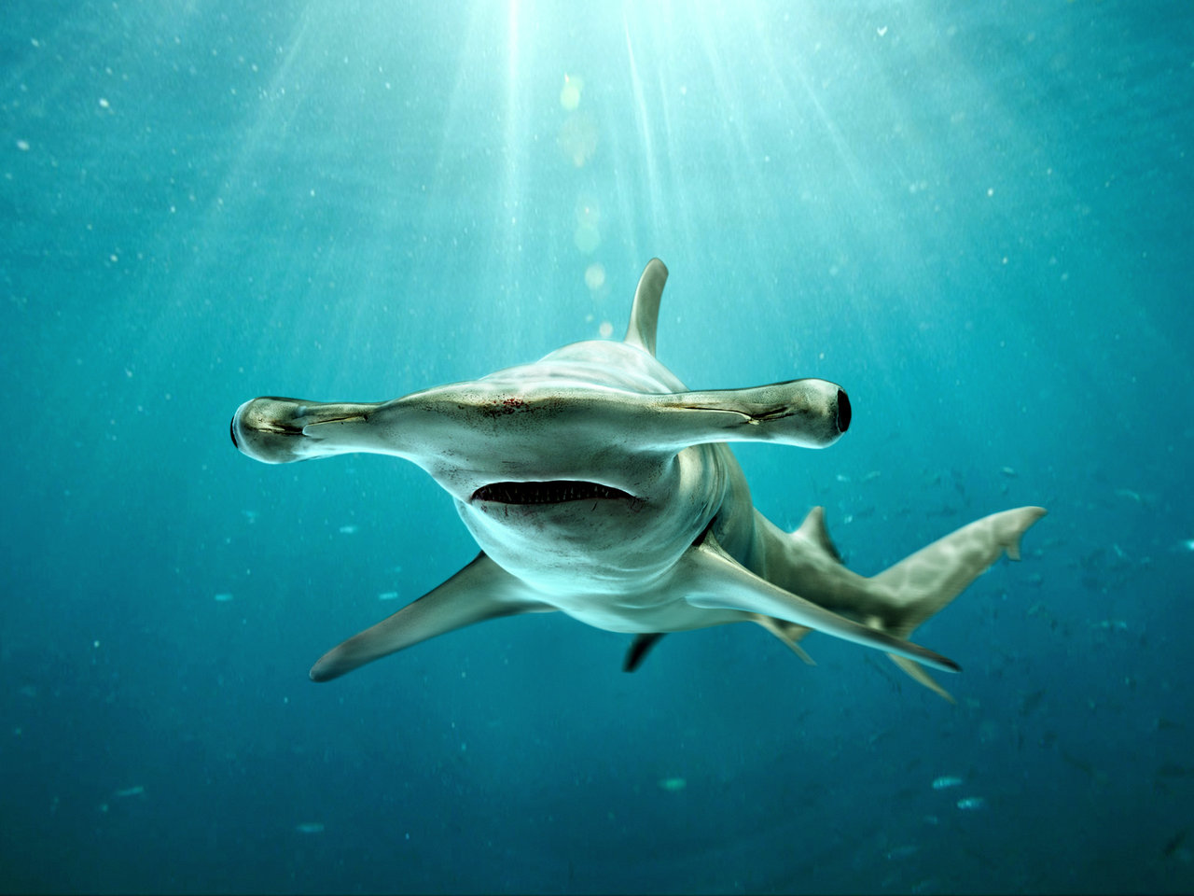
Hammerhead shark
Lucas

Slide 2
body
They look like a hammer

Slide 3
habitat
In warmseas

Slide 4
Foob
Stingray anb squib

Slide 5
Life cycle
Have 42

