Slide 1
Seals
By orayana

Slide 2
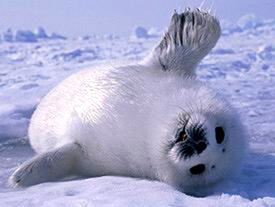
body
They have 4 feet.
They are 3.5 to 16 feet.
They are 1.1 to 5 meters long

Slide 3
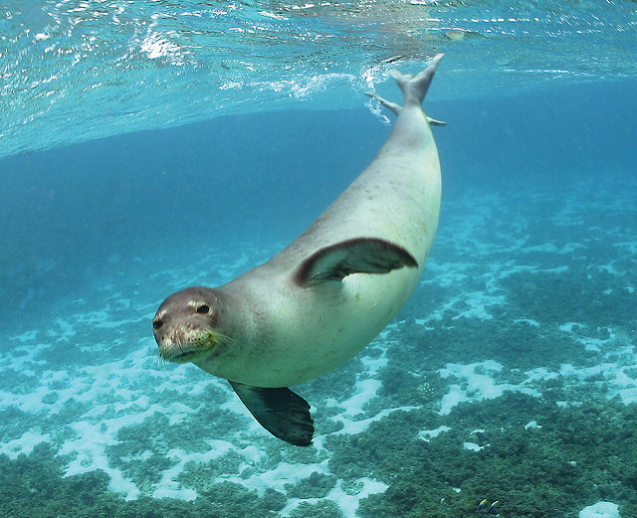
habitat
Seals live in the ocean.
They come to land to lie in the sun give birth.

Slide 4
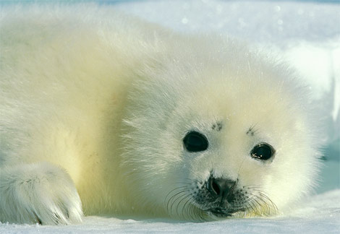
food
Seals eat fish squid krill and even panguins.
Seals have sharp teeth.

Slide 5
Life cycle
Felmale seals have babieso on land.
They give birth one at a time.

Slide 6
Fun fact
Some seals can hold their breath for to hours.

