Slide 1
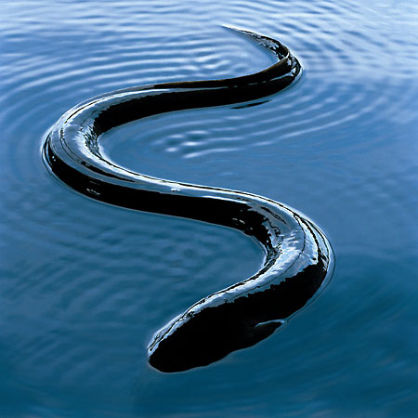
eeLs.
ralph

Slide 2
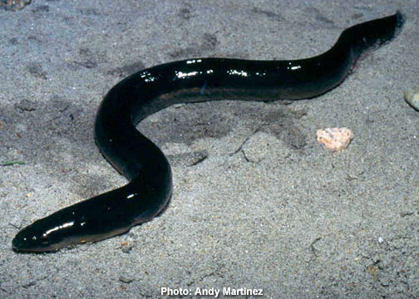
body
EELS LOOK LIKE YELLOW SNAKES.

Slide 3
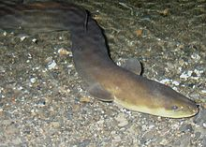
HADITAT
HIDE IN ANOCEANS.

Slide 4
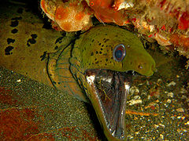
FOOD
EELS EAT FISH. THEYTWO SETS OF TEETH.

Slide 5
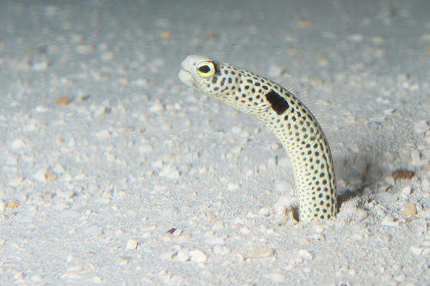
LIFE CYCLE
THEYLOY EGGS.

