Slide 1
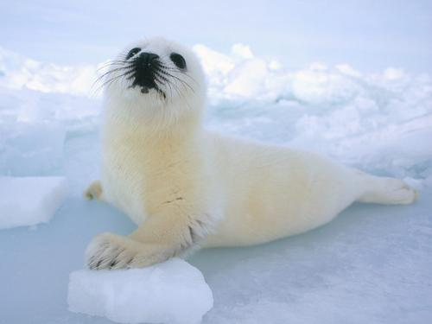
Sea Lions
By Sydney

Slide 2
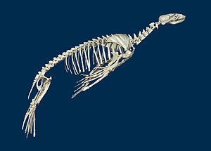
Body
Sea lions are marine mammals with sleek,shiny bodies.
Most are dark gray or brown.

Slide 3
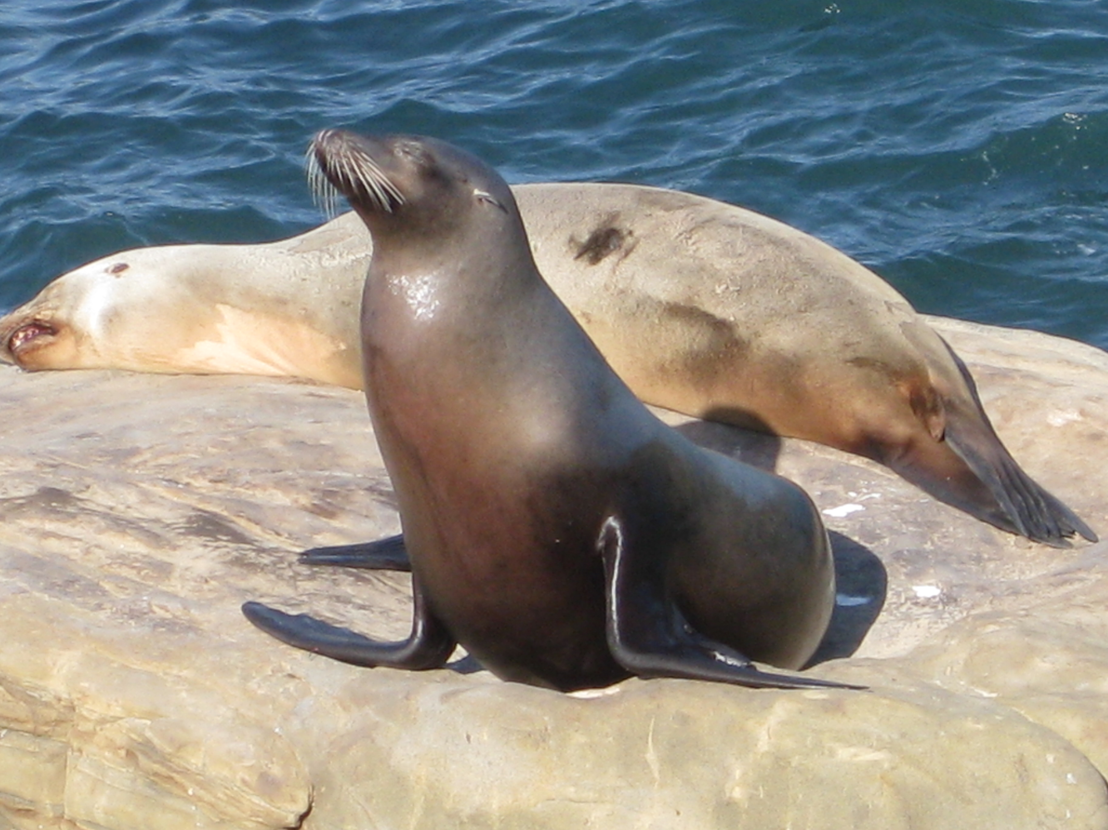
Habitat
Sea lions live in the Pacific Ocean.
Thick layers of blubber keep them warm under water.

Slide 4
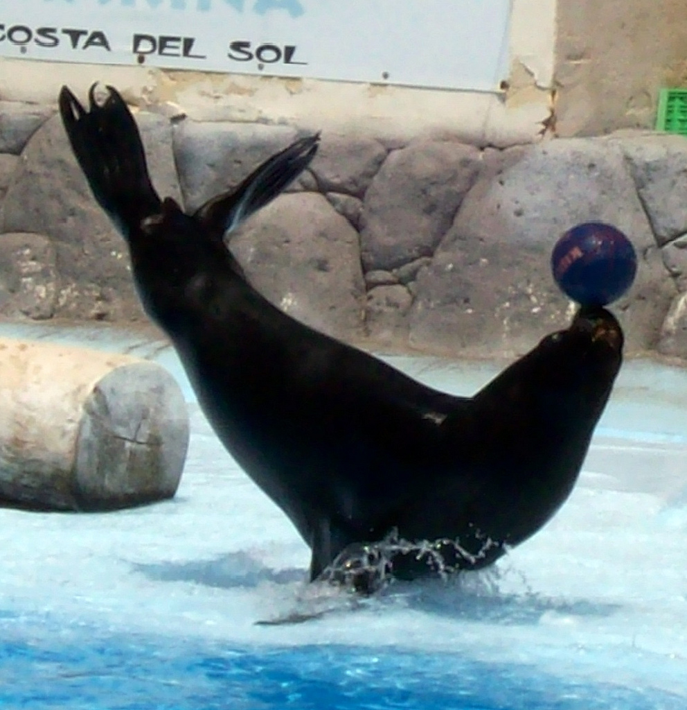
Food
Sea lions eat squid, fish, crabs, and clams.
They swallow most of their food whole.

Slide 5
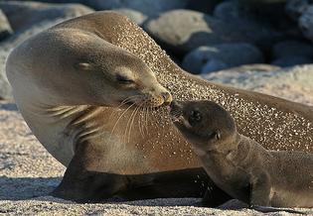
Life Cycle
A female Sea lion gives birth on land.
One pup is born at a time

Slide 6
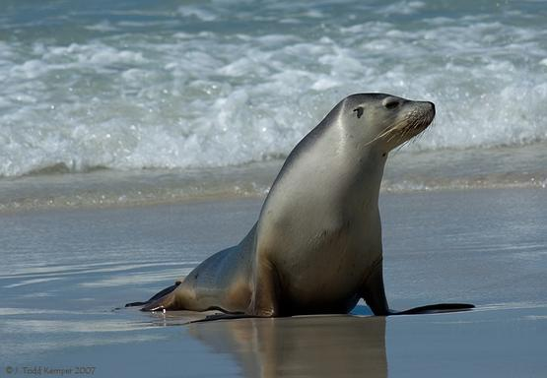
Fun Fact
A Sea lion can hold it,s breath for 40 minutes!

