Slide 1
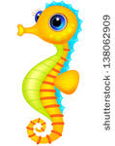
Sea horses
BY Vaelene Bragg

Slide 2
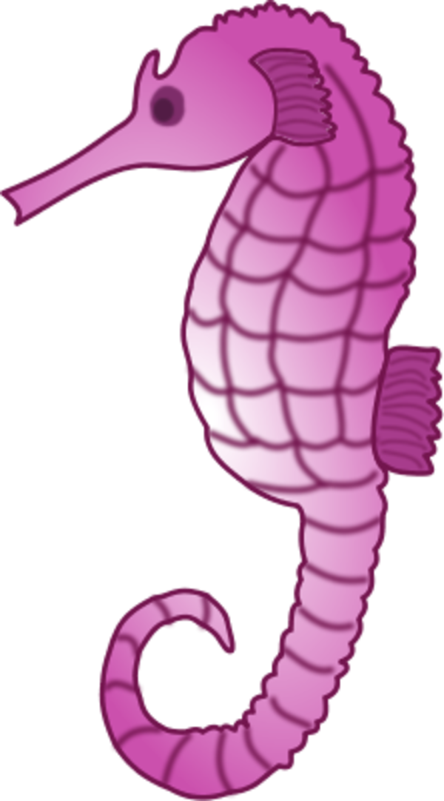
Body
Sea Horses have Bony rings.
They look like Horses

Slide 3
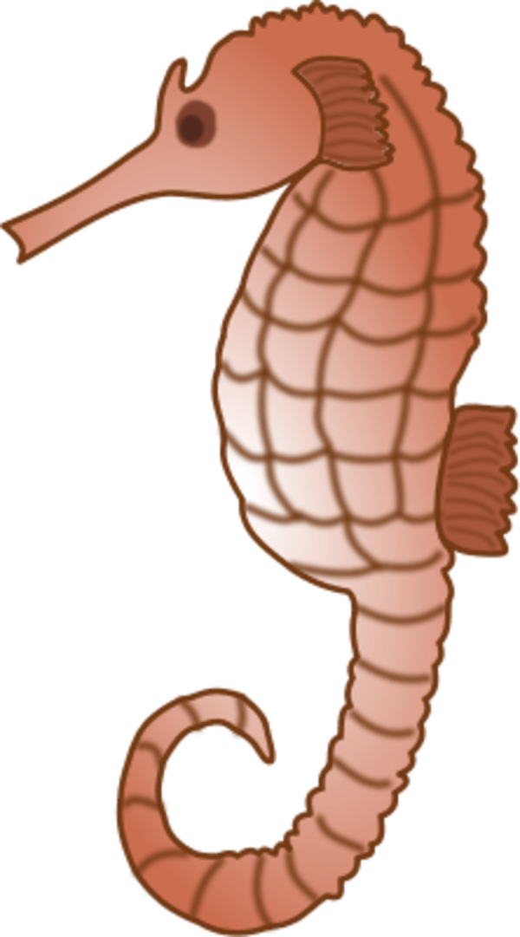
Habitat
Sea Horses live in warm ocean water.

Slide 4
food
Sea Horses eat plankton and shrimp

Slide 5
Life cycle
ThereDAd las egg hatch

Slide 6
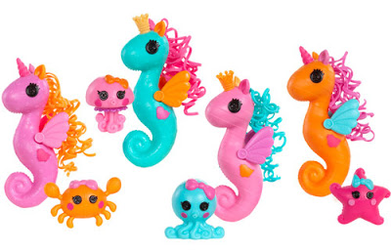
Fun faCt
Swim in pairs

